Slide 1
What’s the Cryptography
This lecture slide is mainly based on the power point slides by Professor Lawrie Brown.
Notes:
Zili Shao

Slide 2
Cryptosystem
A cryptosystem is a 5-tuple consisting of
(E, D, M, K, C)
Where,
E is the set of encryption algorithms
D is the set of decryption algorithms
M is the set of plaintexts
K is the set of keys
C is the set of ciphertexts
E: M × K -> C
D: C × K -> M

Slide 3

Basic Terminology
Plaintext - the original message
Ciphertext - the coded message
Cipher – Consists the Encryption algorithm and the decryption algorithm
Key - info used in cipher known only to sender/receiver
Encipher (encrypt) - converting plaintext to ciphertext
Decipher (decrypt) - recovering ciphertext from plaintext
CEG 260, Meilin Liu
Notes:
Zili Shao
Briefly review some terminology used throughout the course.

Slide 4
What’s the Cryptography
The original intelligible message, referred to as plaintext,
is converted into apparently random nonsense,
referred to as ciphertext. The encryption process consists
of an algorithm and a key.
Cryptography - study of encryption principles/methods
Cryptanalysis (codebreaking) - the study of principles/methods
of deciphering ciphertext without knowing key
Cryptology - the field of both cryptography and cryptanalysis
CEG 260, Meilin Liu
Notes:
Zili Shao

Slide 5
Types of Cryptanalytic Attacks
ciphertext only
  only know algorithm / ciphertext, statistical, can identify plaintext
known plaintext
  know/suspect plaintext & ciphertext to attack cipher
chosen plaintext
  select plaintext and obtain ciphertext to attack cipher
chosen ciphertext (not common)
  select ciphertext and obtain plaintext to attack cipher
CEG 260, Meilin Liu
Notes:
Zili Shao

Slide 6
Types of Cryptanalytic Attacks
Type of Attack | Known to Cryptanalyst
Ciphertext Only | • Encryption algorithm • Ciphertext
Known Plaintext | • Encryption algorithm • Ciphertext • One or more plaintext-ciphertext pairs formed with the secret key
Chosen Plaintext | • Encryption algorithm • Ciphertext • Plaintext message chosen by cryptanalyst, together with its corresponding ciphertext generated with the secret key
Chosen Ciphertext | • Encryption algorithm • Ciphertext • Ciphertext chosen by cryptanalyst, together with its corresponding decrypted plaintext generated with the secret key
Chosen Text | • Encryption algorithm • Ciphertext • Plaintext message chosen by cryptanalyst, together with its corresponding ciphertext generated with the secret key • Ciphertext chosen by cryptanalyst, together with its corresponding decrypted plaintext generated with the secret key
CEG 260, Meilin Liu
Notes:
Zili Shao

Slide 7
Types of Attacks
Brute-force Attacks:
Cryptanalysis Attacks: Linear Cryptanalysis
Differential Cryptanalysis
CEG 260, Meilin Liu
Notes:
Zili Shao

Slide 8
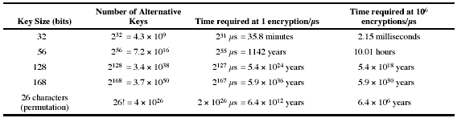
Brute Force Search
Always possible to simply try every key
Most basic attack, proportional to key size
Assume either know / recognize plaintext
CEG 260, Meilin Liu
Notes:
Zili Shao

Slide 9
Cryptographic System
CEG 260, Meilin Liu
Notes:
Zili Shao

Slide 10
Three Classes
Secret Key System (Symmetric Key System)
Public Key System (Asymmetric Key System)
CEG 260, Meilin Liu
Notes:
Zili Shao

Slide 11
Secret Key System
The keys for the encryption and the decryption algorithm
are the same.
All classical encryption algorithms are private-key
The only type prior to invention of public-key in 1970’s
Some well-known secret key systems: DES、RC2、RC4、
IDEA、SAFER、FEAL、Skipjack、Blowfish, AES.
CEG 260, Meilin Liu
Notes:
Zili Shao

Slide 12
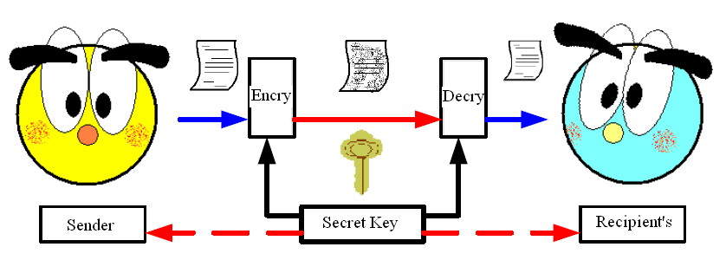
Secret Key System
CEG 260, Meilin Liu
Notes:
Zili Shao

Slide 13
Public Key System
The keys for both the encryption and the decryption algorithms are different.
There are two keys in a “Key Pair”: one is public Key, and the other one is private Key.
The public key will be published before practicing the public key System.
CEG 260, Meilin Liu
Notes:
Zili Shao

Slide 14
Public Key System – Cont.
Public Key System can be used for encryption/decryption and digital signature.
Some well-known public key systems: Diffie-Hellman、RSA、ElGamal、DSA、Knaspack、Rabin.
CEG 260, Meilin Liu
Notes:
Zili Shao

Slide 15
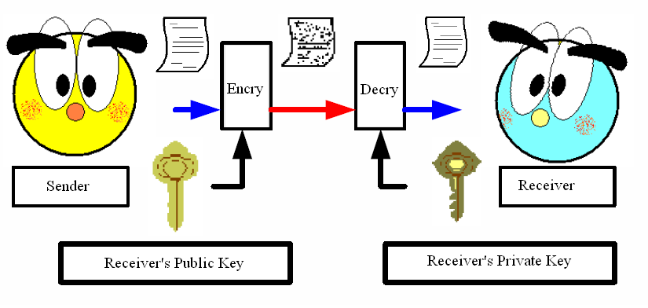
Public Key System
CEG 260, Meilin Liu
Notes:
Zili Shao

Slide 16
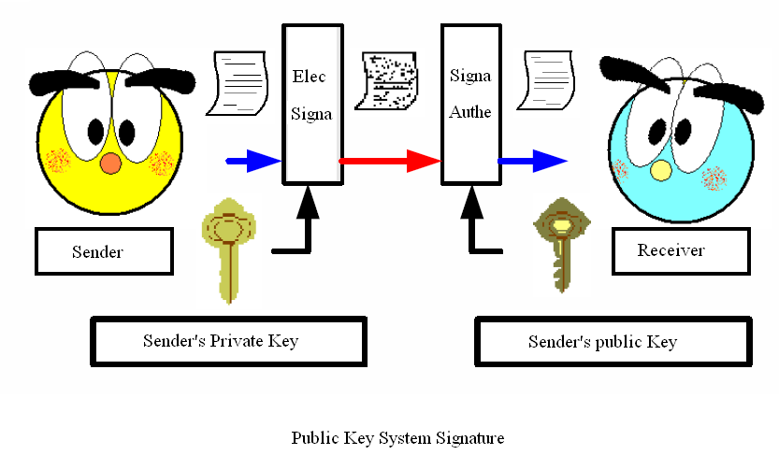
Public Key System
CEG 260, Meilin Liu
Notes:
Zili Shao

